Slide 1
GRID RUNNER
Created by:
Kostiantyn Makrasnov
Rudyjay Keopuhiwa
Niklas Roberts
Stephen Haugland

Slide 2
Project Description
Goal: recreate Splix.io
Multiplayer game
Players capture area on the board
Players lose if they hit the edge of the board or run into one another
Players move without stopping
Notes:
nik

Slide 3
Challenges
Getting assembler to work with C++ networking code
Properly tracking all the players and their path/territory
Could only access local variables from C++ in inline assembler
Notes:
Rudy

Slide 4
Coordinate System
X increments right
Y increments down
Data structures used
0,0 | 1,0 | 2,0
0,1 | 1,1 | 2,1
0,2 | 1,2 | 2,2
Notes:
Kostia

Slide 5
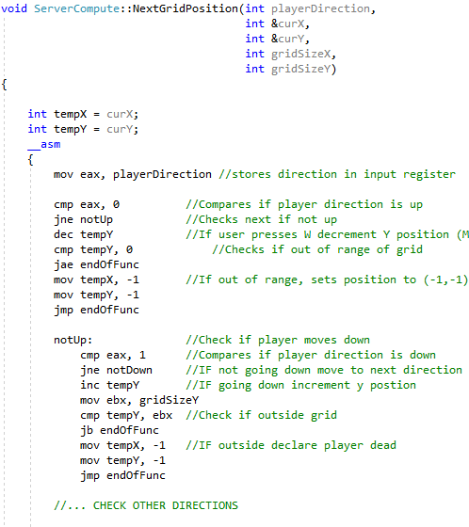
Movement Code
Function inputs
Temp variables
Conditional jumps
Notes:
Stephen

Slide 6
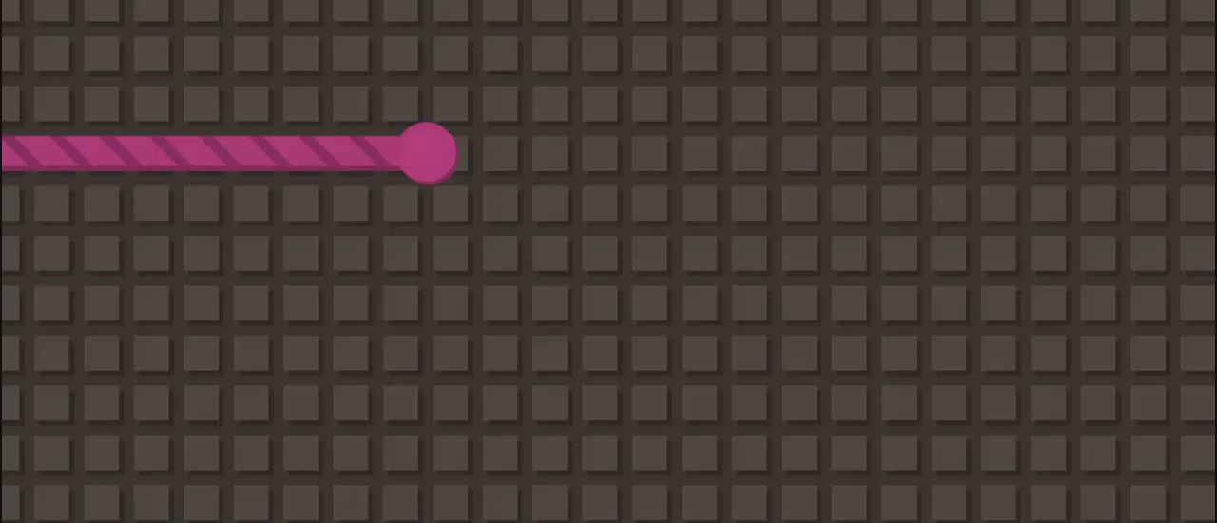
Other Assembler Dependent Functions
DrawGrid(): Controls iteration over a 2D vector and allows us to see the game board
SetDrawColor(): formulates color ID based on r,g,b, and intensity properties of a grid point
Notes:
Kostia

Slide 7
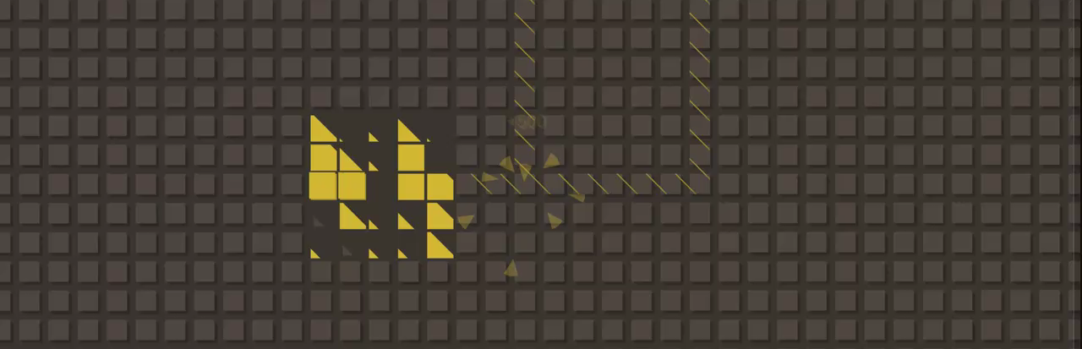
Lessons Learned
Lowest-level coding rocks
Inline assembler use cases
Feature prioritization (time)
Notes:
All

Slide 8
Demo Time!
Everyone can play!
1. Go to “[INSERT PATH]”
2. Extract Archive “GridRunnerClient.zip”
3. Open “ClientAssembler.exe”
4. Fullscreen console press F11
5. Input the IP of server “[INSERT IP]”
5. Press ENTER to join

Slide 9
THANKS!
Any questions?
Template Credits: Slides Carnival
Image Credits: Splix.io

